Slide 1
PROBABILITY AND STATISTICS
CHI-SQUARE/T - DISTRIBUTION
MATH 30: PROBABILITY AND STATISTICS

Slide 2
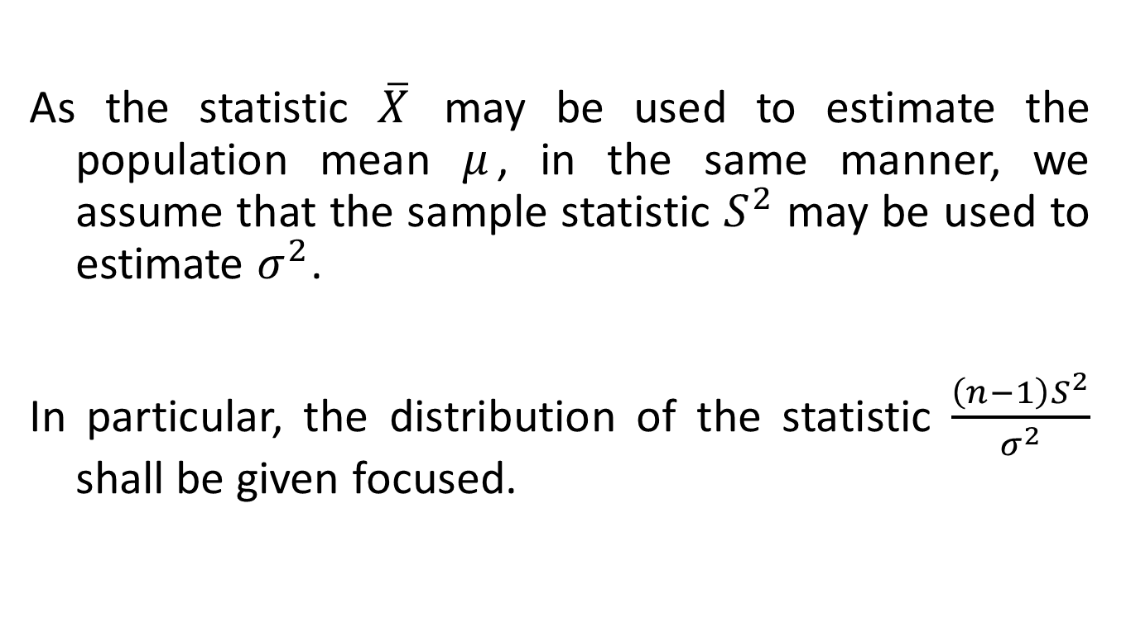
Sampling Distribution for the Variance
As the statistic $\overline{X}$ may be used to estimate the population mean $μ$, in the same manner, we assume that the sample statistic $S^{2}$ may be used to estimate $σ^{2}$.
In particular, the distribution of the statistic $\frac{\left(n−1\right)S^{2}}{σ^{2}}$ shall be given focused.
MATH 30: PROBABILITY AND STATISTICS

Slide 3
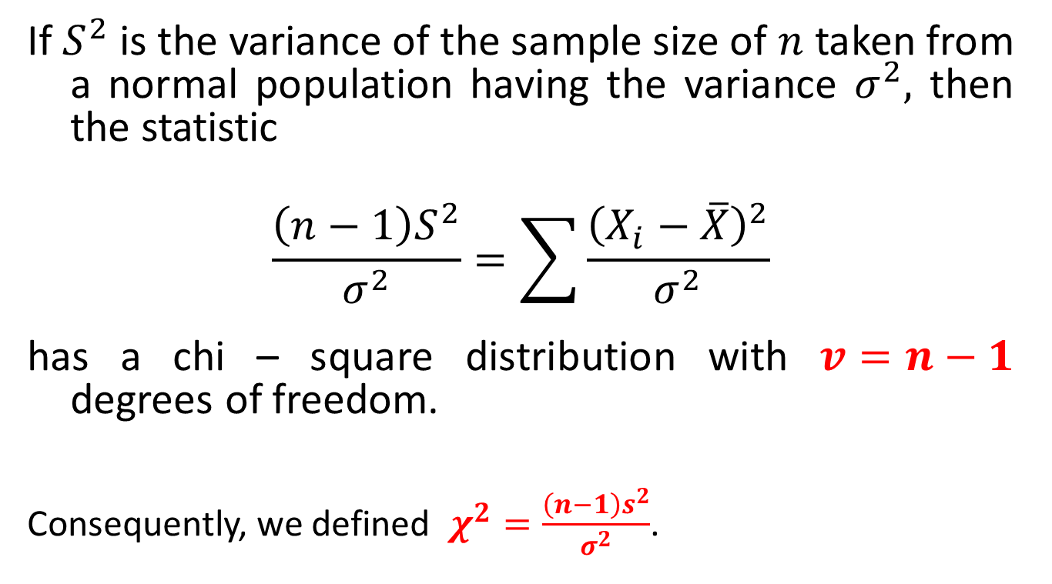
Sampling Distribution for the Variance
If $S^{2}$ is the variance of the sample size of $n$ taken from a normal population having the variance $σ^{2},$ then the statistic
$$\frac{\left(n−1\right)S^{2}}{σ^{2}}=\sum{\frac{{\left(X_{i}−\overline{X}\right)}^{2}}{σ^{2}}}$$
has a chi – square distribution with $v=n−1$ degrees of freedom.
Consequently, we defined $χ^{2}=\frac{\left(n−1\right)s^{2}}{σ^{2}}$.
MATH 30: PROBABILITY AND STATISTICS

Slide 4
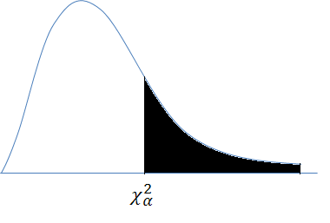
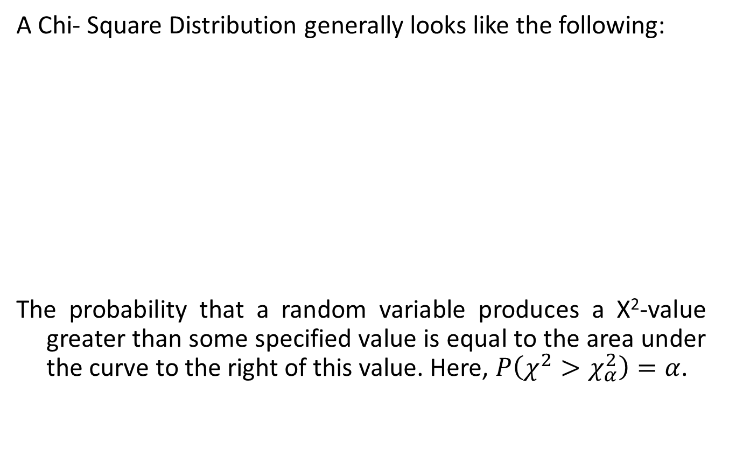
Chi-square DISTRIBUTION
A Chi- Square Distribution generally looks like the following:
The probability that a random variable produces a Χ²-value greater than some specified value is equal to the area under the curve to the right of this value. Here, $P\left(χ^{2}>χ_{α}^{2}\right)=α$.
MATH 30: PROBABILITY AND STATISTICS

Slide 5
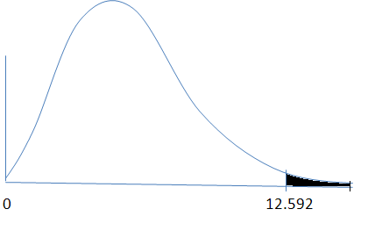
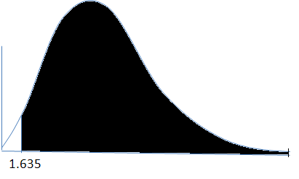

Chi-square DISTRIBUTION
If we consider the values of $χ_{0.05}^{2}=12.592$ and $χ_{0.95}^{2}=1.635$
with degrees of freedom 6, we have
This implies that $P(χ^{2}>12.592)=0.05$ and $P\left(χ^{2}>1.635\right)=0.95$. Bearing this in mind, we have $P\left(1.635<χ^{2}<12.592\right)=0.90$.
MATH 30: PROBABILITY AND STATISTICS

Slide 6
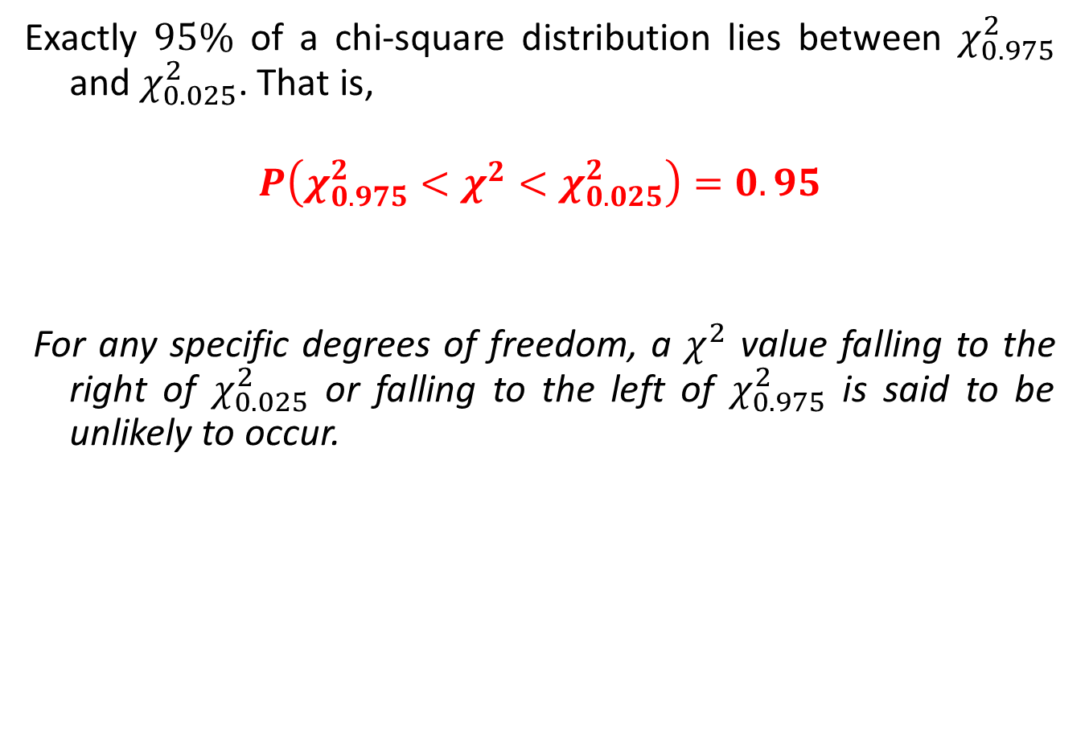
Chi-square DISTRIBUTION
Exactly $95\%$ of a chi-square distribution lies between $χ_{0.975}^{2}$ and $χ_{0.025}^{2}$. That is,
$$P\left(χ_{0.975}^{2}<χ^{2}<χ_{0.025}^{2}\right)=0.95$$
For any specific degrees of freedom, a $χ^{2}$ value falling to the right of $χ_{0.025}^{2}$ or falling to the left of $χ_{0.975}^{2}$ is said to be unlikely to occur.
MATH 30: PROBABILITY AND STATISTICS

Slide 7
Sampling Distribution for the Variance
ILLUSTRATION:
A manufacturer of car batteries guarantees that his batteries will last, on the average, 3 years with a standard deviation of 1 year. If five of these batteries have lifetimes of 1.9, 2.4, 3.0, 3.5, and 4.2 years, is the manufacturer still convinced that his batteries have a standard deviation of 1 year? Assume that the battery lifetime follows a normal distribution. (Hint: Use the previous claim that all standard deviations are likely to occur within a 95% area)
MATH 30: PROBABILITY AND STATISTICS

Slide 8
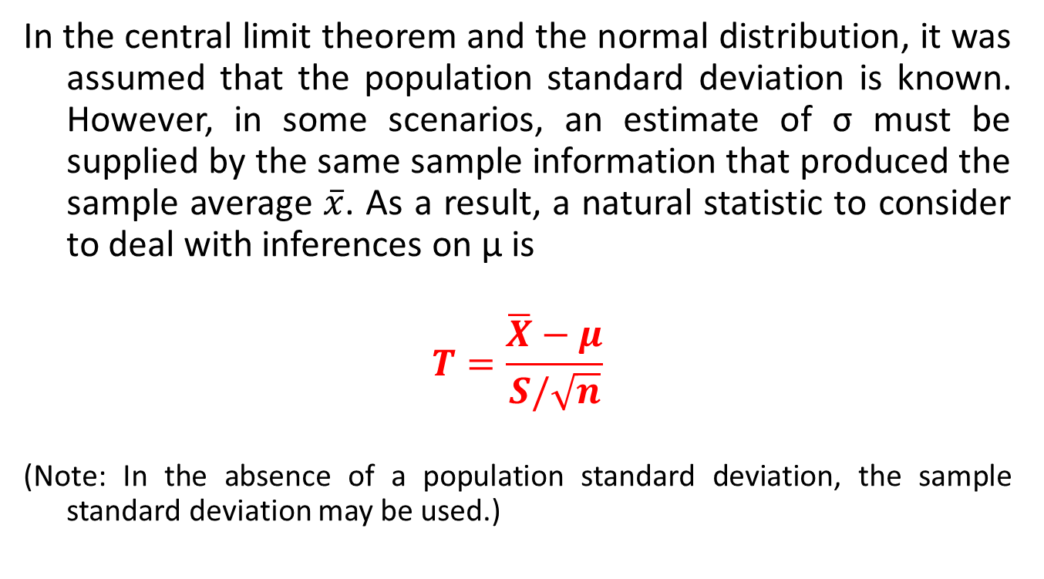
T-DISTRIBUTION
In the central limit theorem and the normal distribution, it was assumed that the population standard deviation is known. However, in some scenarios, an estimate of σ must be supplied by the same sample information that produced the sample average $\overline{x}$. As a result, a natural statistic to consider to deal with inferences on μ is
$$T=\frac{\overline{X}−μ}{S/\sqrt{n}}$$
(Note: In the absence of a population standard deviation, the sample standard deviation may be used.)
MATH 30: PROBABILITY AND STATISTICS

Slide 9
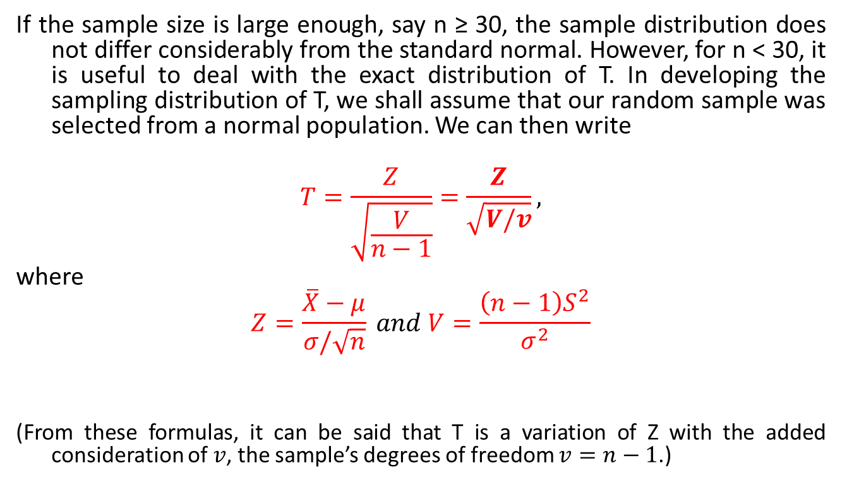
T-DISTRIBUTION
If the sample size is large enough, say n ≥ 30, the sample distribution does not differ considerably from the standard normal. However, for n < 30, it is useful to deal with the exact distribution of T. In developing the sampling distribution of T, we shall assume that our random sample was selected from a normal population. We can then write
$$T=\frac{Z}{\sqrt{\frac{V}{n−1}}}=\frac{Z}{\sqrt{V/v}},$$
where
$$Z=\frac{\overline{X}−μ}{σ/\sqrt{n}} and V=\frac{\left(n−1\right)S^{2}}{σ^{2}}$$
(From these formulas, it can be said that T is a variation of Z with the added consideration of $v$, the sample’s degrees of freedom $v=n−1$.)
MATH 30: PROBABILITY AND STATISTICS

Slide 10
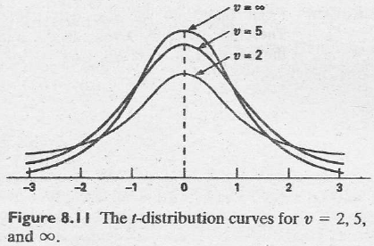
T-DISTRIBUTION
The following are typical T – distribution curves with different degrees of freedom.
MATH 30: PROBABILITY AND STATISTICS

Slide 11
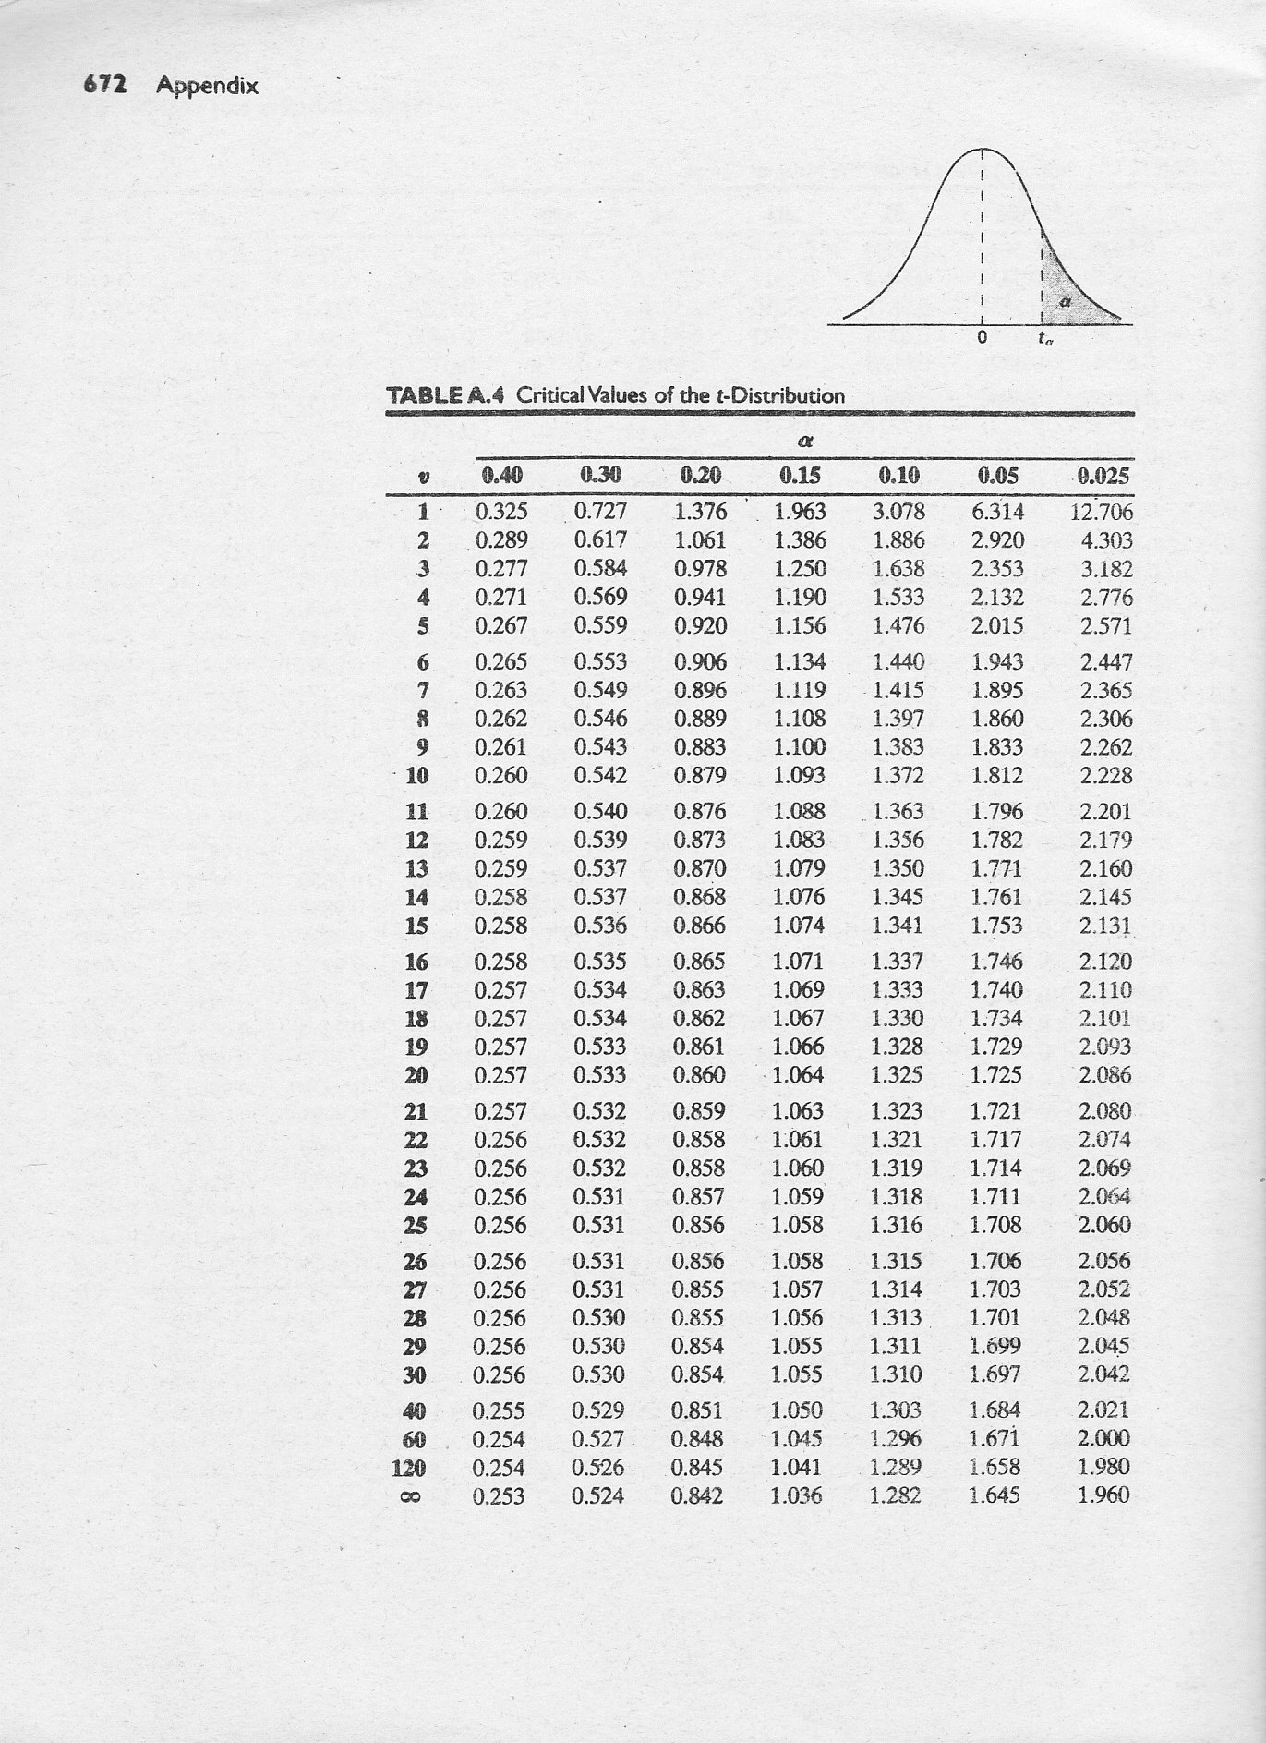
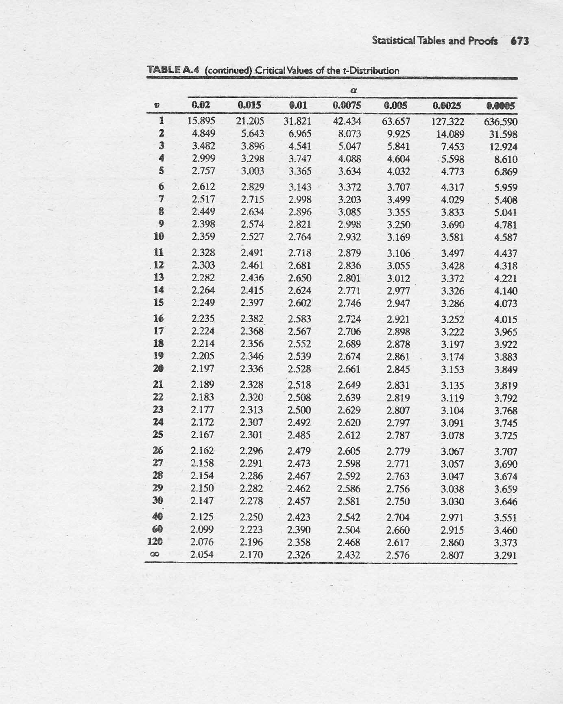
MATH 30: PROBABILITY AND STATISTICS

Slide 12


T-DISTRIBUTION
How does one read t – distribution values?
$t_{α}$ represent the $t−$value which we find an area to the right equal to $α$. Hence, the $t−$value with 10 degrees of freedom that leaves an area of $0.025$ to the right is $t=2.228$.
0.025
$$t$$
0
2.228
MATH 30: PROBABILITY AND STATISTICS

Slide 13
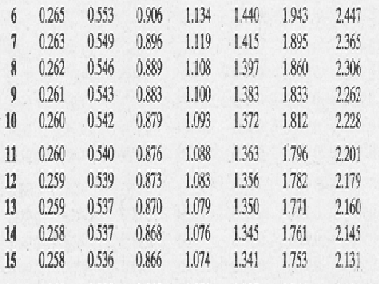
T-DISTRIBUTION
0.261
1.100
2.262
MATH 30: PROBABILITY AND STATISTICS

Slide 14

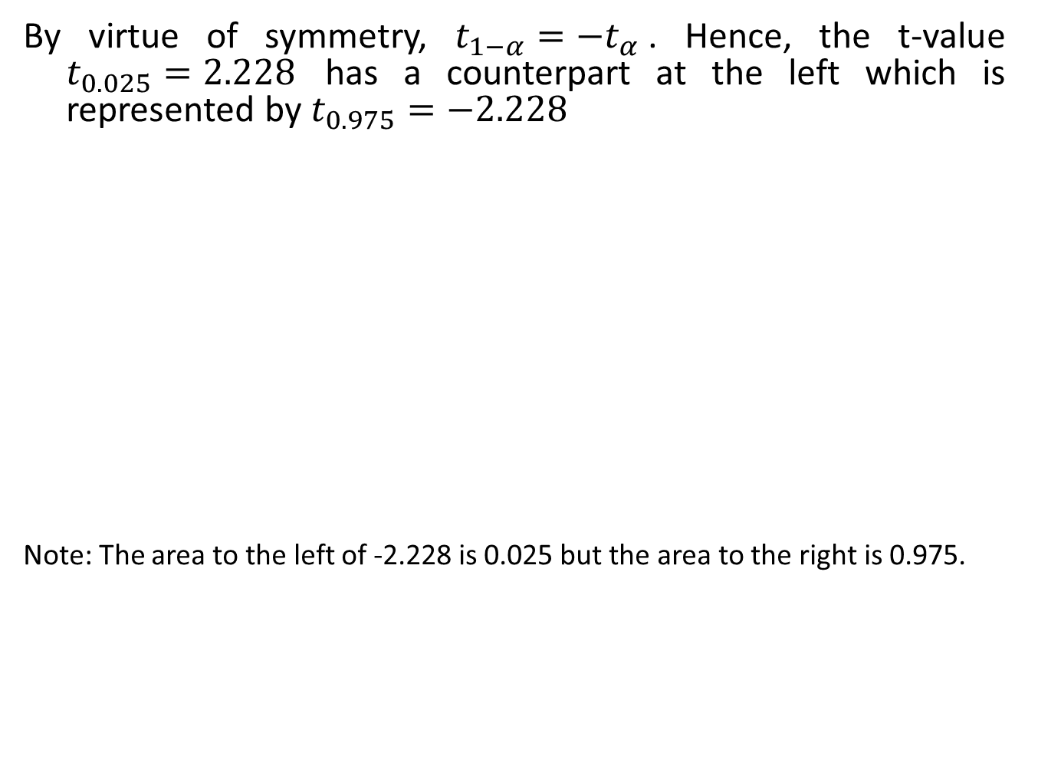
T-DISTRIBUTION
By virtue of symmetry, $t_{1−α}=−t_{α}$. Hence, the t-value $t_{0.025}=2.228$ has a counterpart at the left which is represented by $t_{0.975}=−2.228$
Note: The area to the left of -2.228 is 0.025 but the area to the right is 0.975.
0.025
$$t$$
-2.228
0
2.228
MATH 30: PROBABILITY AND STATISTICS

Slide 15
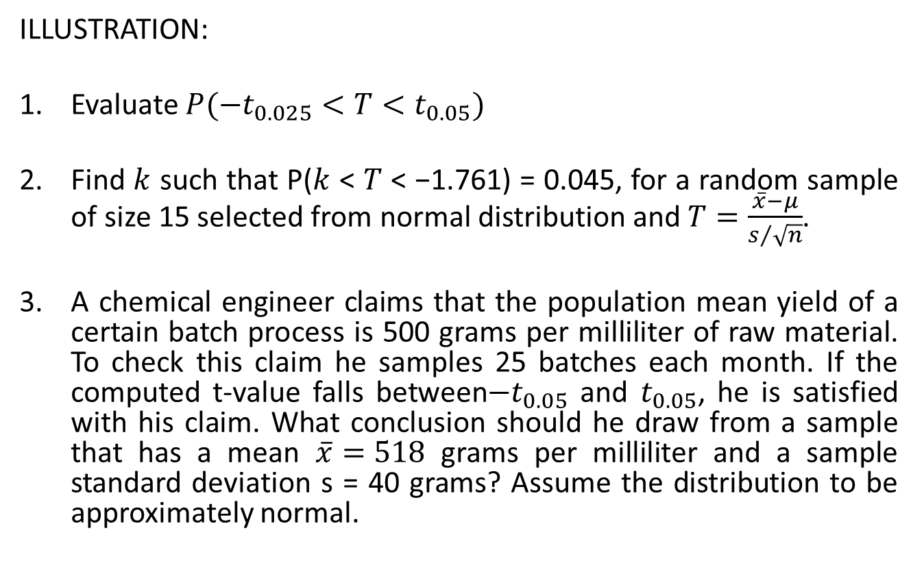
T-DISTRIBUTION
ILLUSTRATION:
Evaluate $P(−t_{0.025}<T<t_{0.05})$
Find $k$ such that P($k$ < $T$ < −1.761) = 0.045, for a random sample of size 15 selected from normal distribution and $T=\frac{\overline{x}−μ}{s/{\sqrt{n}}}$.
A chemical engineer claims that the population mean yield of a certain batch process is 500 grams per milliliter of raw material. To check this claim he samples 25 batches each month. If the computed t-value falls between$−t_{0.05}$ and $t_{0.05}$, he is satisfied with his claim. What conclusion should he draw from a sample that has a mean $\overline{x}=518$ grams per milliliter and a sample standard deviation s = 40 grams? Assume the distribution to be approximately normal.
MATH 30: PROBABILITY AND STATISTICS

